Slide 1
MICROFINANCE LOAN & MANAGEMENT SYSTEM

Slide 2
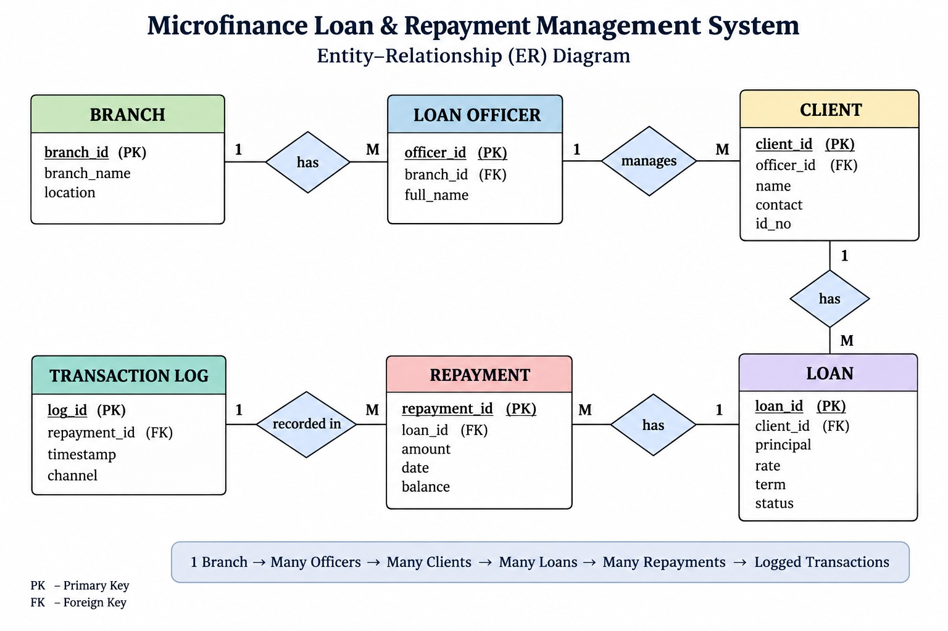

Slide 3
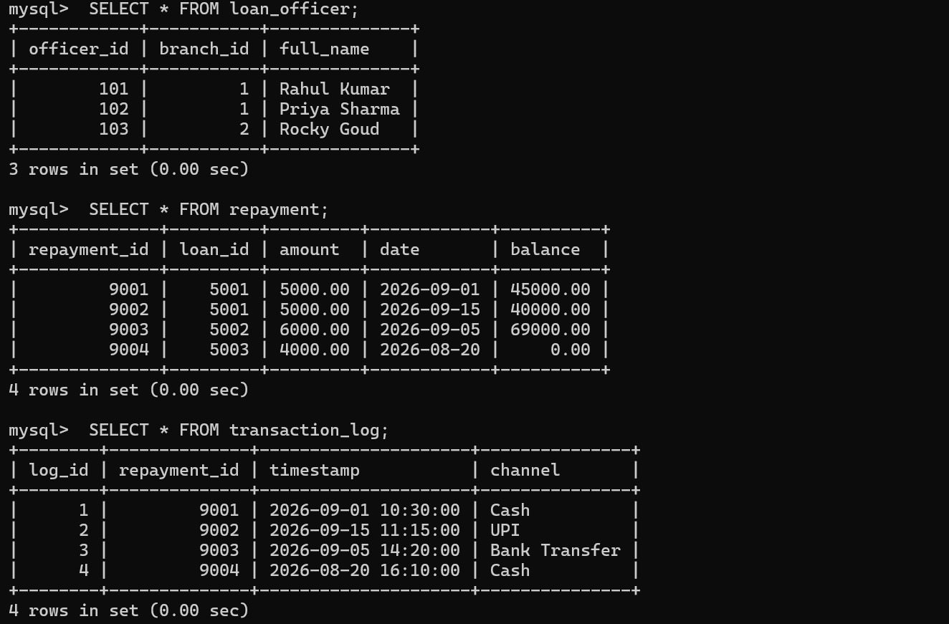

Slide 4
